Slide 1
CS 359 Project Himanshu Dogra Piyush Verma Sudhakar Verma
A Parallel Algorithm with enhancements via Partial Objective Value cuts for Cluster-based Wireless Sensor Network design

Slide 2
The Problem
To develop a parallel algorithm for integrated wireless sensor network design.
Incorporating low-level parallelism, domain decomposition, and multiple-search.
Introduce effective cut inequalities based on parts of the objective function.

Slide 3
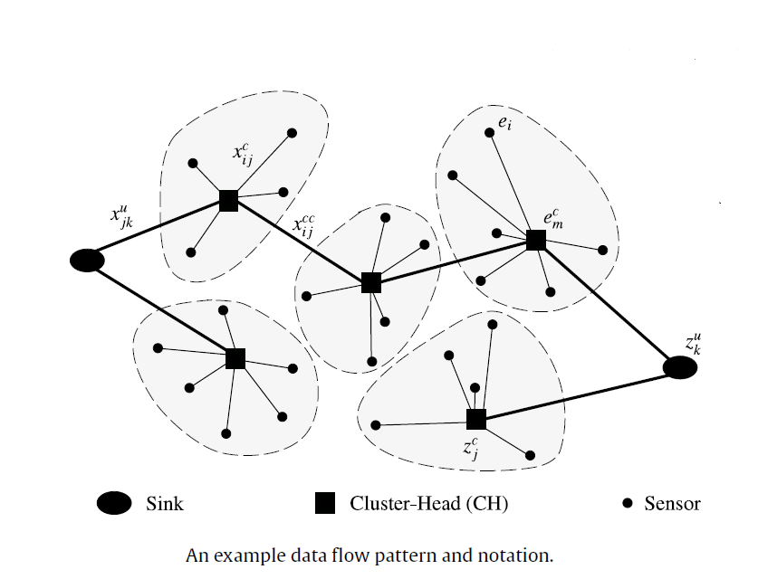

Slide 4
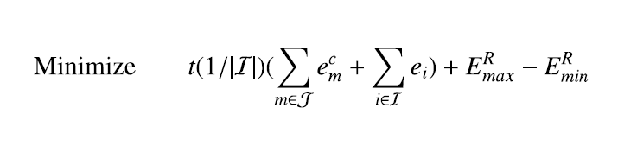
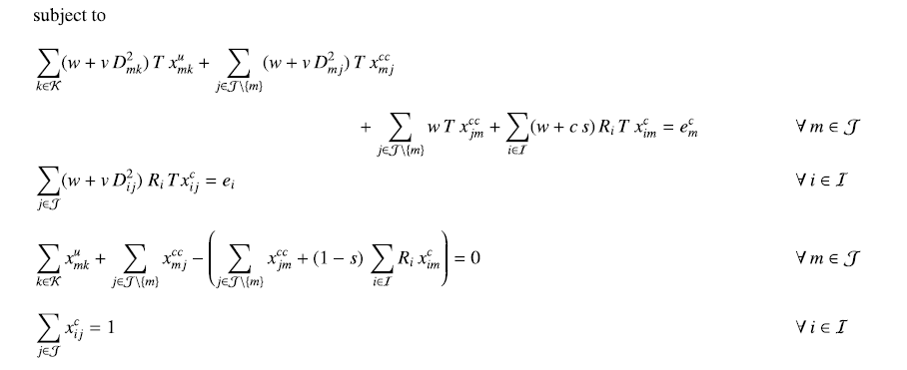
The Objective Function

Slide 5
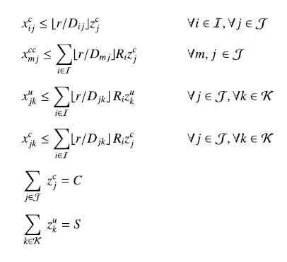

Slide 6
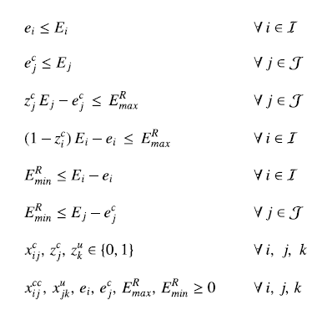

Slide 7
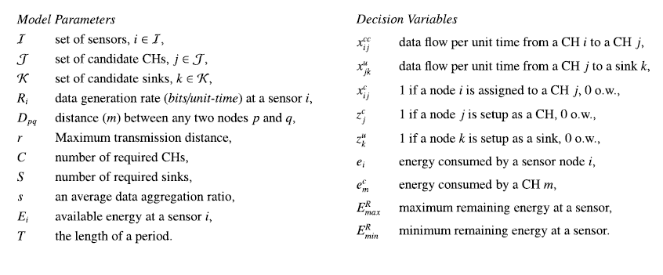

Slide 8
THE APPROACH
Distributed memory Master–Worker model for overall algorithm parallelization.
Parallel SIMPLEX method implemented in C/Python language.
Optimizer to be built based on SMP shared-memory systems.
Takes advantage of multiple processors to solve large linear and difficult mixed integer programs in substantially reduced runtime.

Slide 9
THE APPROACH
Algorithm divided into 3 sub-procedures.
Master is run at one node.
Master controls the flow of overall algorithm and solves one sub-problem.
Workers run on different nodes.
Workers solve the remaining sub-problems.
This includes the Heuristic Search, involving solutions of some of the sub-problems (in parallel) & generating cuts.

Slide 10
Test Instance Generation
|I| Sensor Coordinates to be generated randomly.
Uniformly distributed in a square of size N (m) and |K| potential sink location coordinates along the periphery of the sensor field.
3 values of C considered for each of the 12 Problem Settings.
Performance evaluation on the basis of solution quality and time.

Slide 11
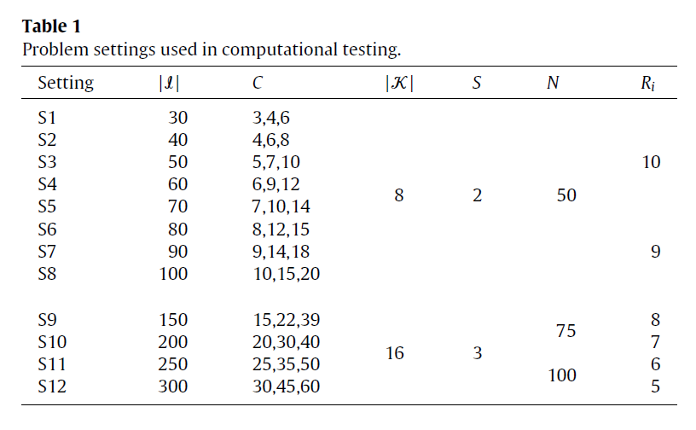

Slide 12
Model & Machine Configuration
Mixed shared/distributed memory architecture.
Performed on a cluster of 8-way SMP nodes.
Each node has 8 processors.
Master Process is run on one node.
Worker Processes are run on the remaining nodes.
To be implemented using C/Python.
MPI for process communications.

